Slide 1
DofE Assembly
Ian Turnbull Expedition Supervisor

Slide 2
10 Reasons to Choose DofE

Slide 3
1. It is the leading Youth Achievement Award.
In West Yorkshire…
Awards started
Awards achieved
8,829
young people started their DofE journey in 2017-18
4,371
Young people achieved their DofE award in 2017-18
Nationally…

Slide 4
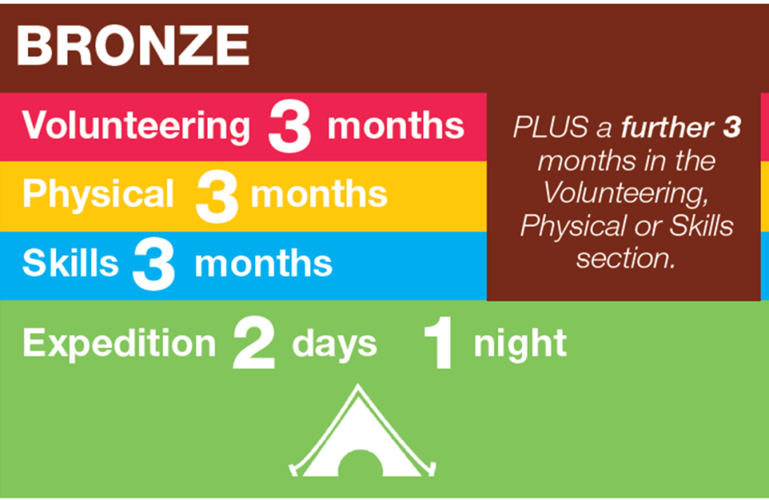
2. You will design your own DofE…
Volunteering
Make a positive difference to other people’s lives
Physical
Improve in an area of sport, dance or fitness
Skill
Develop practical, social skills and personal interests
Expedition
Plan, train and complete an adventurous journey in the UK or abroad

Slide 5
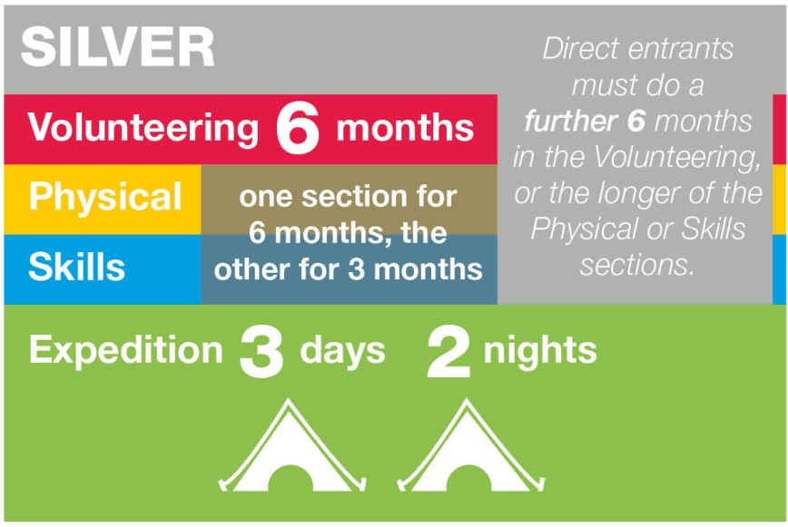
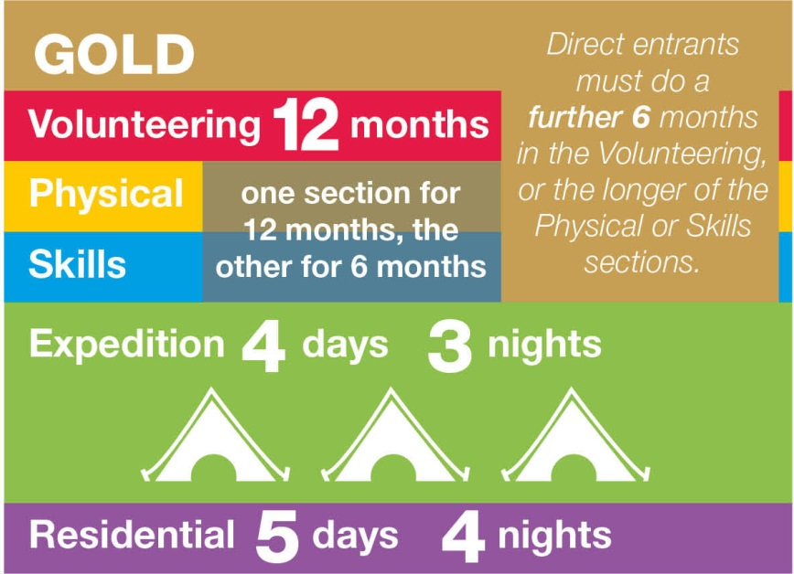
… to Silver and Gold.

Slide 6
3. You will choose a VOLUNTEERING activity… Make a ‘positive’ difference to other people.
Helping others (e.g. in reading club, elderly, younger children, people in need, Drama, Librarian)
)
Sports Coaching (rugby, football, netball)
Animal Welfare (e.g. RSPCA, Guide Dogs)
School Mentoring
Fundraising / Charity Shop
Subject Ambassadors (Art, Maths, ICT…)
School Charity Committee

Slide 7
4. You will choose a PHYSICAL activity… Feel healthier, get fit.
Team sports… football, netball
Individual sports …gymnastics, boxing
Water sports …swimming, canoeing
Dance
Fitness… walking, yoga, gym, fitness classes
Racquet sports.. Badminton, tennis
Martial Arts

Slide 8
5. You will choose a SKILL activity… Develop a personal interest or work on a talent.
Care of animals… dog handling, keeping of pets
Science & Technology… afterschool science clubs, IT
Life skills… Cookery, hair & beauty
Natural world …gardening, plant growing
Performing arts… singing, drama,
Media.. Film/video making, journalism/blogging
Music
Creative arts.. Drawing, photography, knitting
Learning & collecting.. Languages, fashion, astronomy

Slide 9
6. You will have an adventure… Plan and take part in an EXPEDITION.
Preparation Meeting
Training and Practice
Qualifying expedition & presentation
( Assessed )

Slide 10
Bronze - Nidderdale

Slide 11
Silver – North York Moors Gold – Yorkshire Dales

Slide 12
7. Taking part in DofE offers lots of benefits.
Respect
Give back to others in the community
Work as part of a team
Challenging
Plan and use time effectively
Independence
Be a Leader
Communication
Job Applications
Teamwork
New relationships
Respect
CV
Builds self esteem
Confidence
A sense of identity
New Talents
Awareness of your potential
Self-belief
6th Form / College applications
Self Belief
Give back to others in the community
Challenging
UCAS
FUN
Responsibility
New Abilities
Self-confidence
Understanding of strengths and weaknesses
Problem solving
Keep Fit
Ability to learn from others

Slide 13
8. DofE can have a positive effect on your life.

Slide 14
9. Employers value DofE.
Are you a UK company or organisation
that values DofE Award holders?

Slide 15
10. It’s worthwhile, it’s recognised, it’s FUN and it will make you stand out.

Slide 16
How to get involved.
Take a letter and enrolment form and return by the letter date.
Identify activities that you would like to do for the Volunteering, Skill and Physical sections and Residential for Gold Participants.
Ask non family appropriate adults if they will act as assessors.

