Slide 1



Year 11 Information evening
Thursday 24th September

Slide 2


Slide 3
Year 11 GCSE Outcomes 2026
 | ALL | SEN
Attainment 8 | 51.1 | 33.9
4+English and Maths | 72.2% | 44%
5+ English and Maths | 54.6% | 25%
A8 we are top 4 out of 9 schools Maths 4+ (2nd in the city) Ebacc APS- 2nd highest in the city EBacc 4+ 2nd in the city Ebacc 5+ 1st in the city When we compare against NA (2025) we are above on: A8, Basics 4+ and 5+, PP : Attainment 8, Basics 5+ SEN: Attainment 8, Basics 4+ and 5+ |  | Attainment 8- Average score across best 8 grades. Average Point Score (APS) The average grade/score when all grades are added together for each student. English Baccalaureate (EBacc)- Students achieving the suite of English, maths, science, a language, and history or geography.

Slide 4

Aims of this evening:
Share key dates/ Key people - the year ahead
Study habits/ Revision strategies
Supporting your child’s wellbeing
Opportunity to speak to the Year 11 Team, SEND and SLT
Purchase revision resources
Meet post 16 Providers

Slide 5
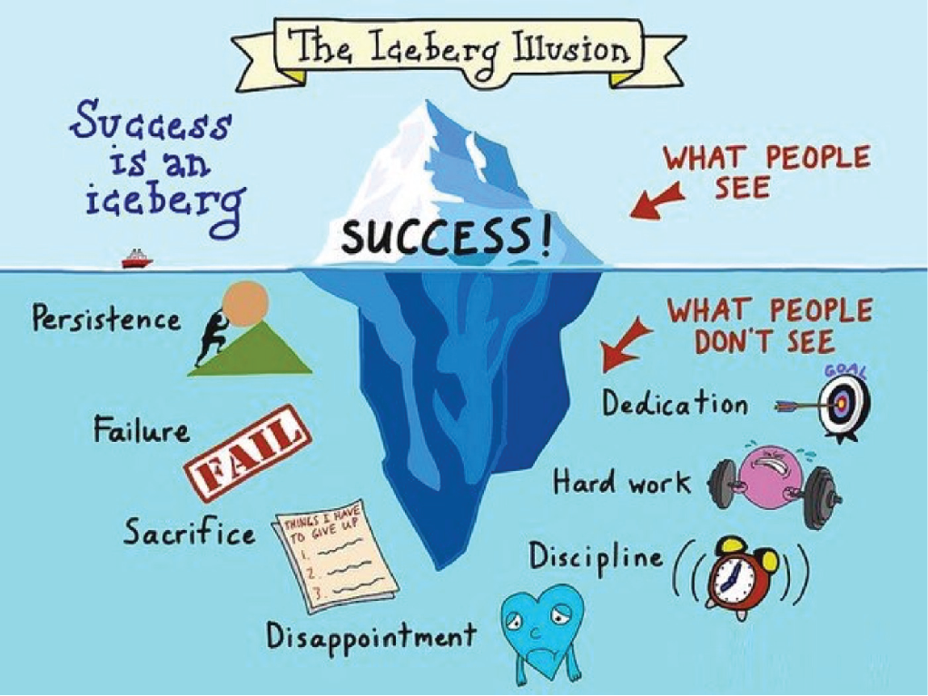
How can I be successful this year?

Slide 6

Support this year...planned but responsive
Expertly planned, timed and delivered lessons
Teachers are the experts- examiners
Regular Standardised Assessments- Every Mark Matters
Walking Talking Mock Exams
PPE
How to revise sessions
SEND Support
Year Team
Form Tutor
Attendance Team
Exams Team
SEND (send@millthorpe.elt.org.uk) Access arrangements
exams@millthorpe.elt.org.uk
All other communication- admin@millthorpe.elt.org.uk

Slide 7
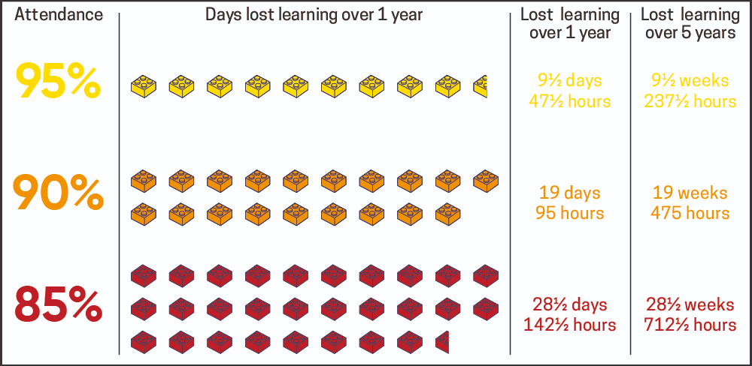

Attendance- School
The single biggest thing that you can do is to try to ensure that your child is in school, on time, every day. Every day missed means that they are missing key content and skills that could be on their final GCSE exam. As there is so much content to cover, we will not have time to revisit this. Every Day Matters!

Slide 8
Attendance- School
An example from GCSE History:
Lesson 4 - Causes of the Korean War
Lesson 5 - How the Korean War developed
Lesson 5 - Consequences of the Korean War
GCSE Exam Question - Write an account of how the Korean War developed 1950-1953 (8 marks)
If your child was absent on the day when lesson 5 was delivered, how would they fare in the exam?

Slide 9


Attendance- School

Slide 10

Attendance- School
Real data
Our students
Last year

Slide 11
Attendance- School
We know that sometimes, being absent from school is unavoidable. We are not trying to panic you or your child, but the research and statistics cannot be ignored.
If you need help or support regarding attendance, we want to work with you.
Please contact attendance@millthorpe.elt.org.uk and the team will be in touch. We have a dedicated and highly skilled team who will do everything that they can to ensure that your child is in school every day.

Slide 12

Key dates…..
Progress Reports and Evenings - Main Hall
1st December (week commencing)- Progress Report 1
Wednesday 9th December 3.30pm-6.30pm
15th February (week commencing)- Progress Report 2
Wednesday 3rd March 3.30-6.30pm
Please bring your child! It’s their evening….ownership of learning.
Post-16 representation available at the evening.

Slide 13
Key dates/events…..
PPEs (Pre-Public Examinations)
Internal examinations took place in summer of Y10 and will take place:
GCSE questions.
Marked rigorously according to GCSE mark schemes- Every Mark Matters approach.
Give students clear feedback on their level of performance.
Enable students to plan their next steps for improvement.
Requires students to revise – helps them with the final examination at the end of the course.
Allows teachers to identify gaps in learning and plan accordingly
Rehearse the experience

Slide 14
Key dates/events…..
PPEs (Pre-Public Examinations)
20th October- English Language
12th October to 16th October- MFL Speaking
November - Creative Subjects- 3D Design, Graphics and Art
9th March- English Literature
From 11th-29th January- All subjects

Slide 15
Key dates…..
GCSE Practical Assessments 15th March- start of exams
GCSE Public examinations - 4th May - 18th June
GCSE Contingency Day- 23rd June
All exams are taken at the end of the course, in Summer 2027*
(*only exception is some Non-Examination Assessments for practical subjects)
Master Class timetable which support short term preparation for the exams.

Slide 16
Key dates…..
Prom: Friday 18th June @ York Racecourse (5.30-10.30pm)
Leavers Brunch and leavers assembly: 21st June
Results Day: Thursday 19th August (arrangements to be made if unable to collect)

Slide 17

Intervention
Form time
Afterschool
Tutoring- Maths and English
Attendance is vital
Personalised
Targeted
Intervention attendance will be communicated by Classcharts.

Slide 18

Walking Talking Mocks
Replicate the exam
Exam conditions
Teacher (expert) talks you through each question and explains how to approach it and shows a correct answer
Under a visualiser
Students annotate and write down
Positives- confirms correct thought process, shows thinking and timings.

Slide 19
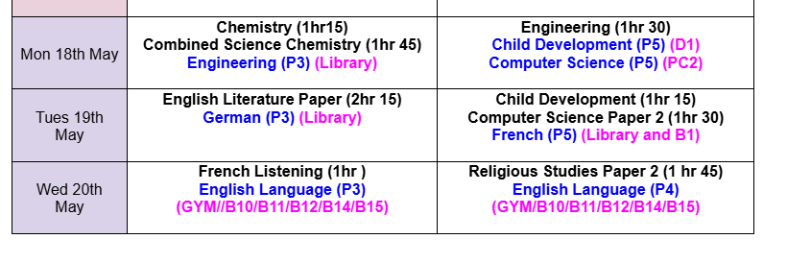
Masterclass Timetable to support Exams:

Slide 20
Masterclass Structure:
Managing emotions: entering the exam- first actions once you are told to open the paper. Instilling an ‘attack mentality’. Fight for every mark/every mark matters. Stop and pause.
Review of exam structure: timings and marks for each question/section/exam
Top tips for each question: Feedback from last year examiners report
Deconstruct Question types: approach to answers
Pitfalls to avoid: Feedback from last year examiners report
Crisis points: what to do if panic sets in.
Review Tricky knowledge areas.
Model answers: various marks
Resources: Students need a resource to fill in/annotate.

Slide 21
Post 16 Destinations and entry requirements…
Applications start in November
Students supported via careers appointments and Personal Development time.
Entry requirements differ depending on level (2 / 3)
Students need a minimum of a Grade 5 to study the subject at A Level (Level 3) and minimum of 5 subjects.
Some A Levels, especially Mathematics, need a Grade 6 at GCSE
Students who don’t get Grade 4 or better in English Language or Mathematics must retake them.

Slide 22
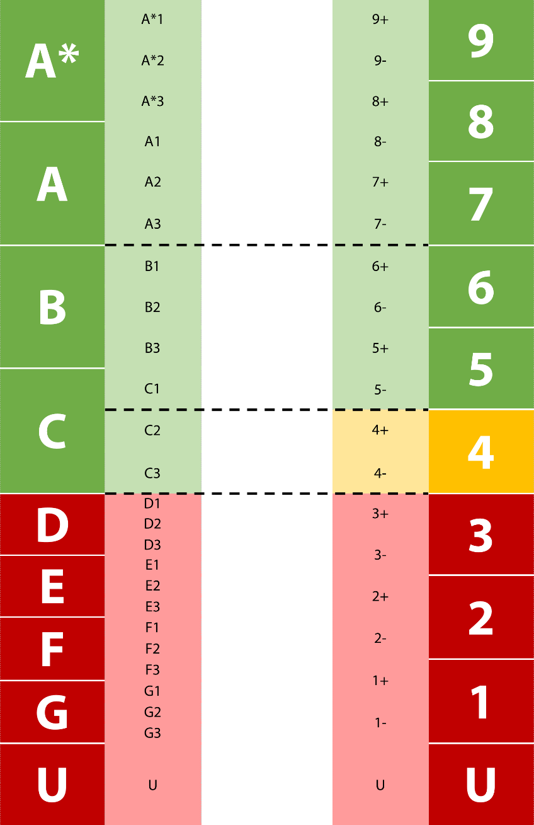
GCSE Grades vs historic
Grade 4 = C grade
Grade 7 = A grade
In all subjects except:
Engineering and Child Development
Pass (P1 or P2), Merit (M2) and Distinction (D2 or D*2)

Slide 23

You have told us… we have listened
Ambitions Week
Careers appointments
Specific feedback for staff
Subject specific
I don’t know how to revise….I am not sure my revision is working. How do I learn quotes?
How do i revise Maths?

Slide 24


Exam Rubric and Revision

Slide 25
What is Exam Rubric?
A rubric is a document which makes explicit the criteria by which students’ assessments are marked.
At Millthorpe, we recognise the value of Exam Rubric in supporting each student to understand how to make the progress necessary to achieve excellence in each subject.
Each department/GCSE subject has written an Exam Rubric guide that is regularly used within, and outside of, lessons to support teaching and learning and includes, as a minimum, the following four key parts:
Description - Task/Assignment/Exam Overviews for Each Paper, Grade Boundaries.
Criteria - Assessment Objectives, Mark Schemes, Inserts/Formula Grids, Knowledge Organisers, ‘Top Tips’.
Levels - Explicit Success Criteria for Each Level or Grade Point.
Standards - Model examples of Answers at Each Grade Point, including 100% Answers, with Clear Rationale, Key Points from Examiner Reports.

Slide 26
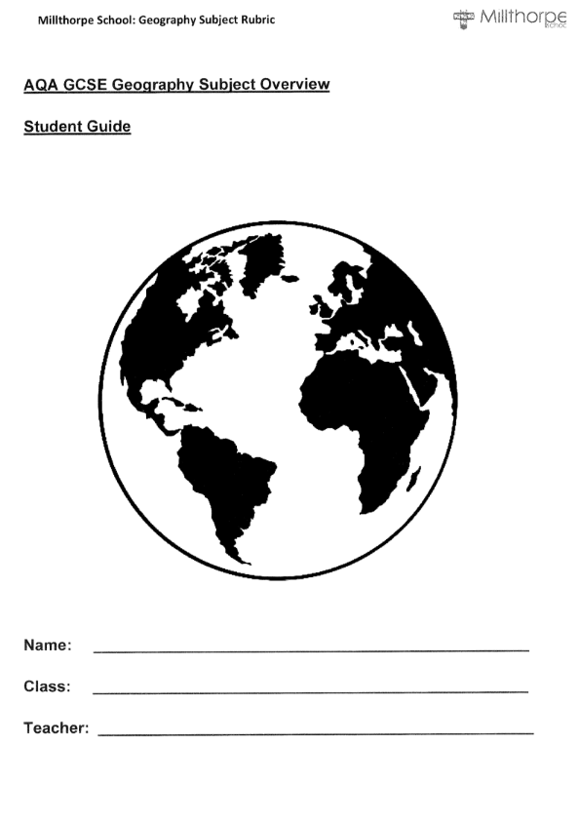
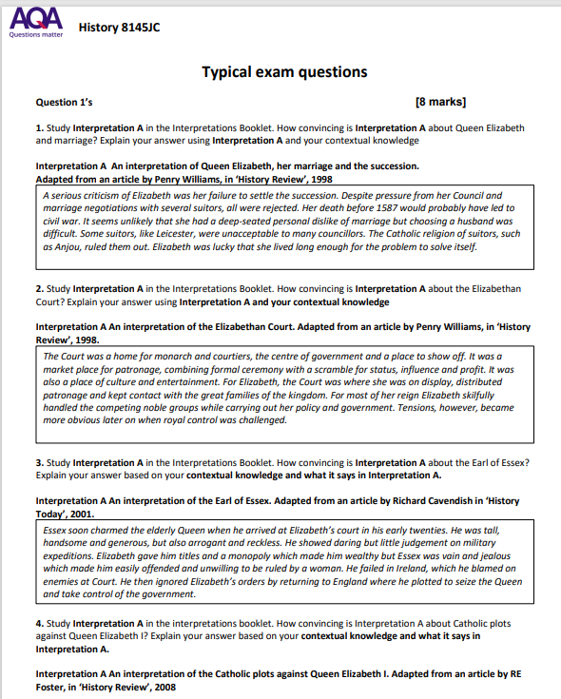
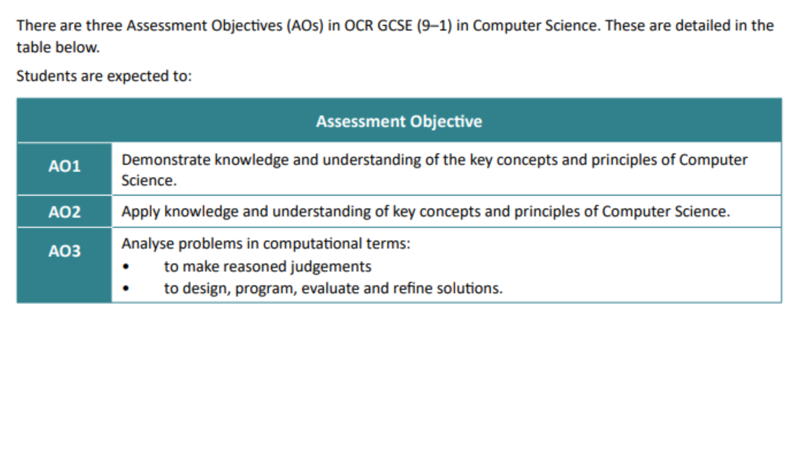
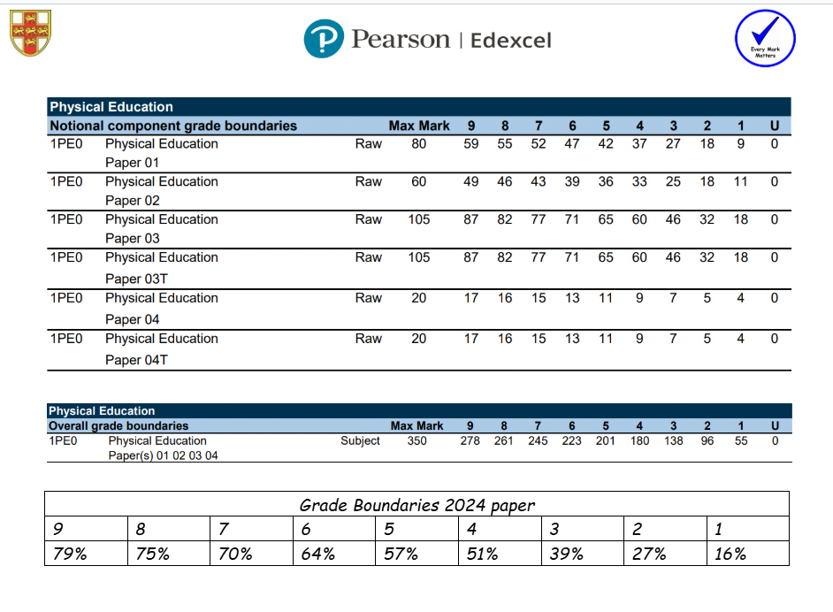
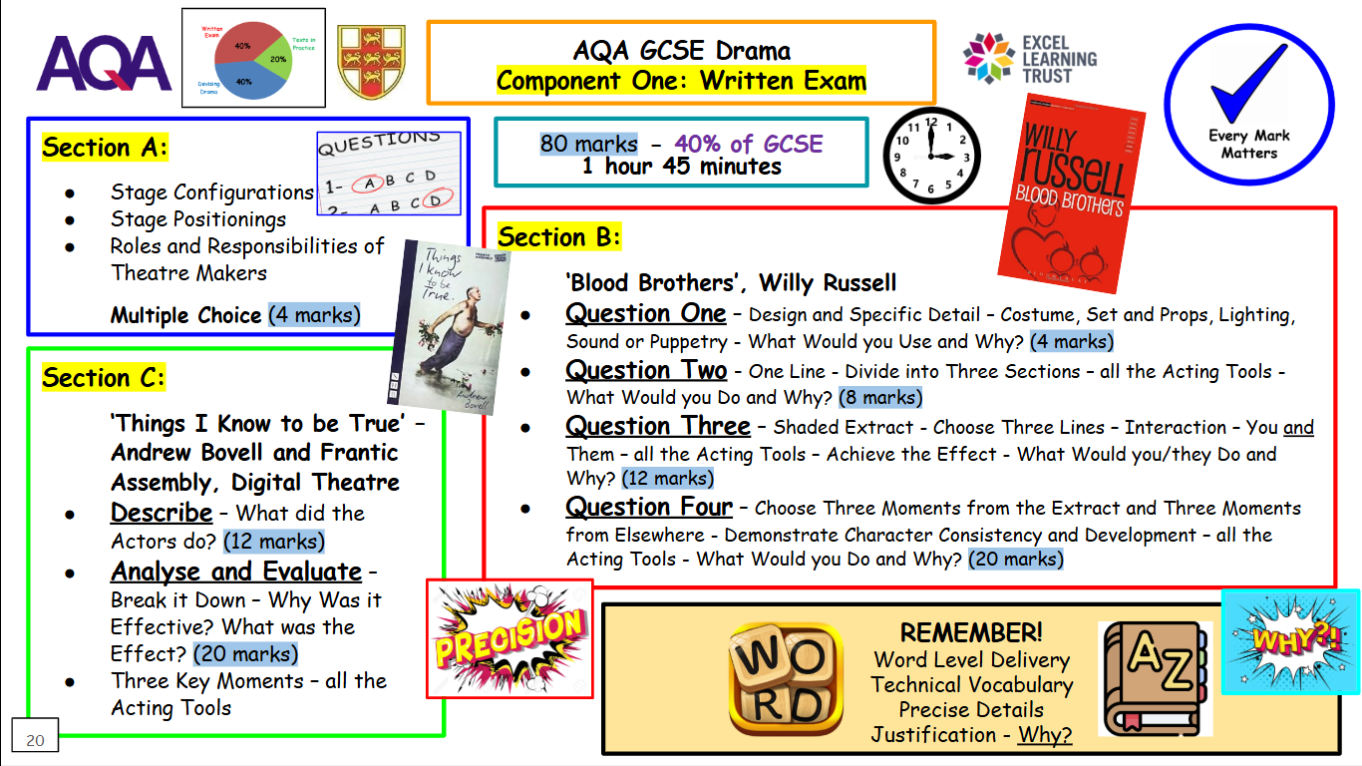
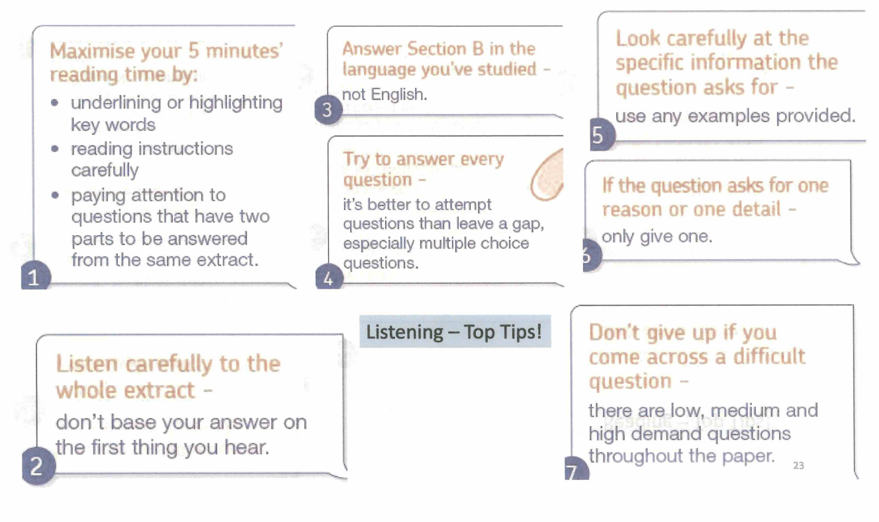
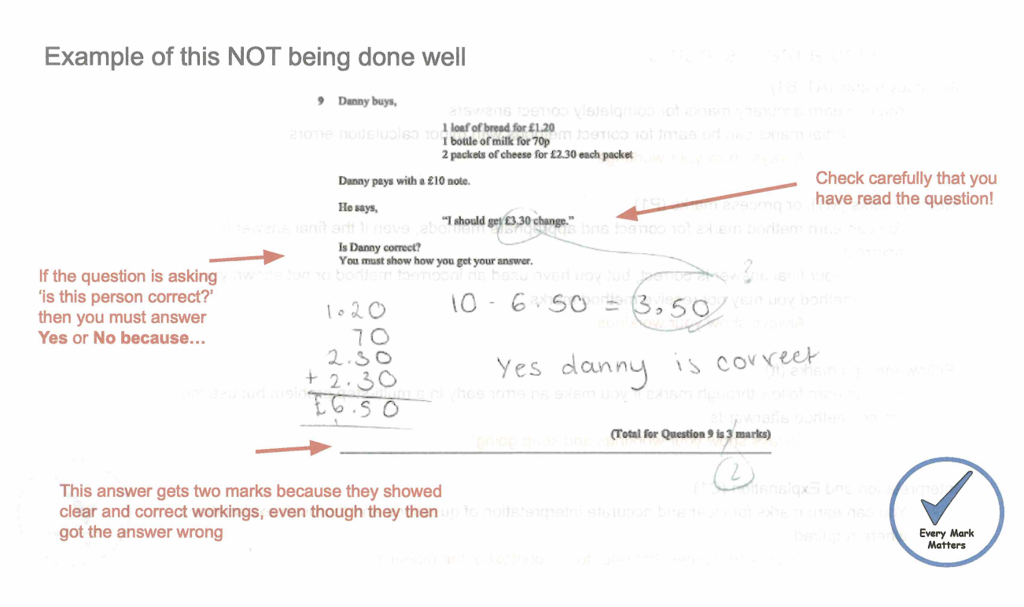
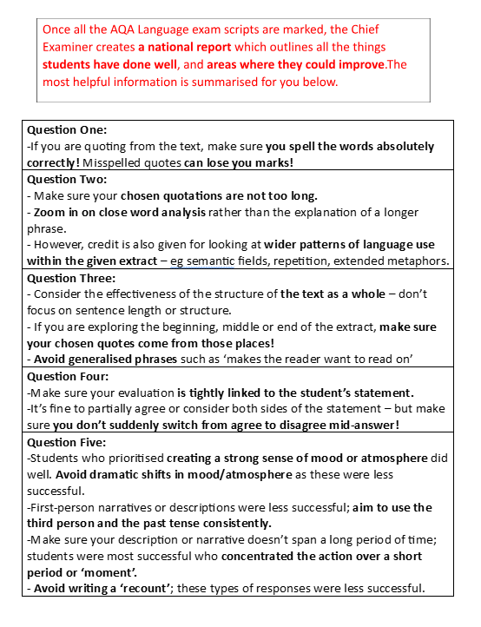
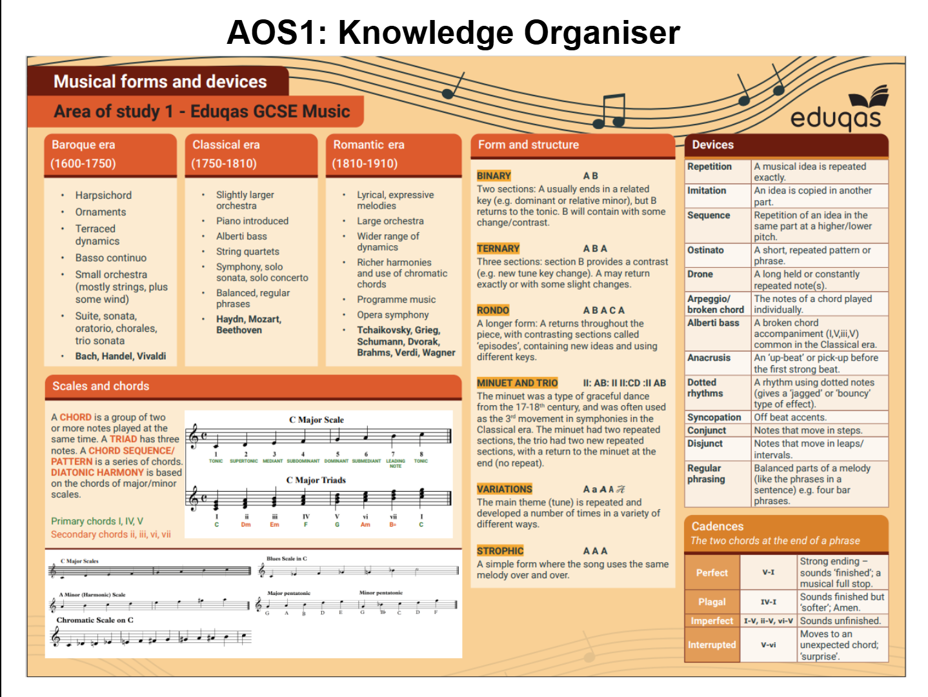
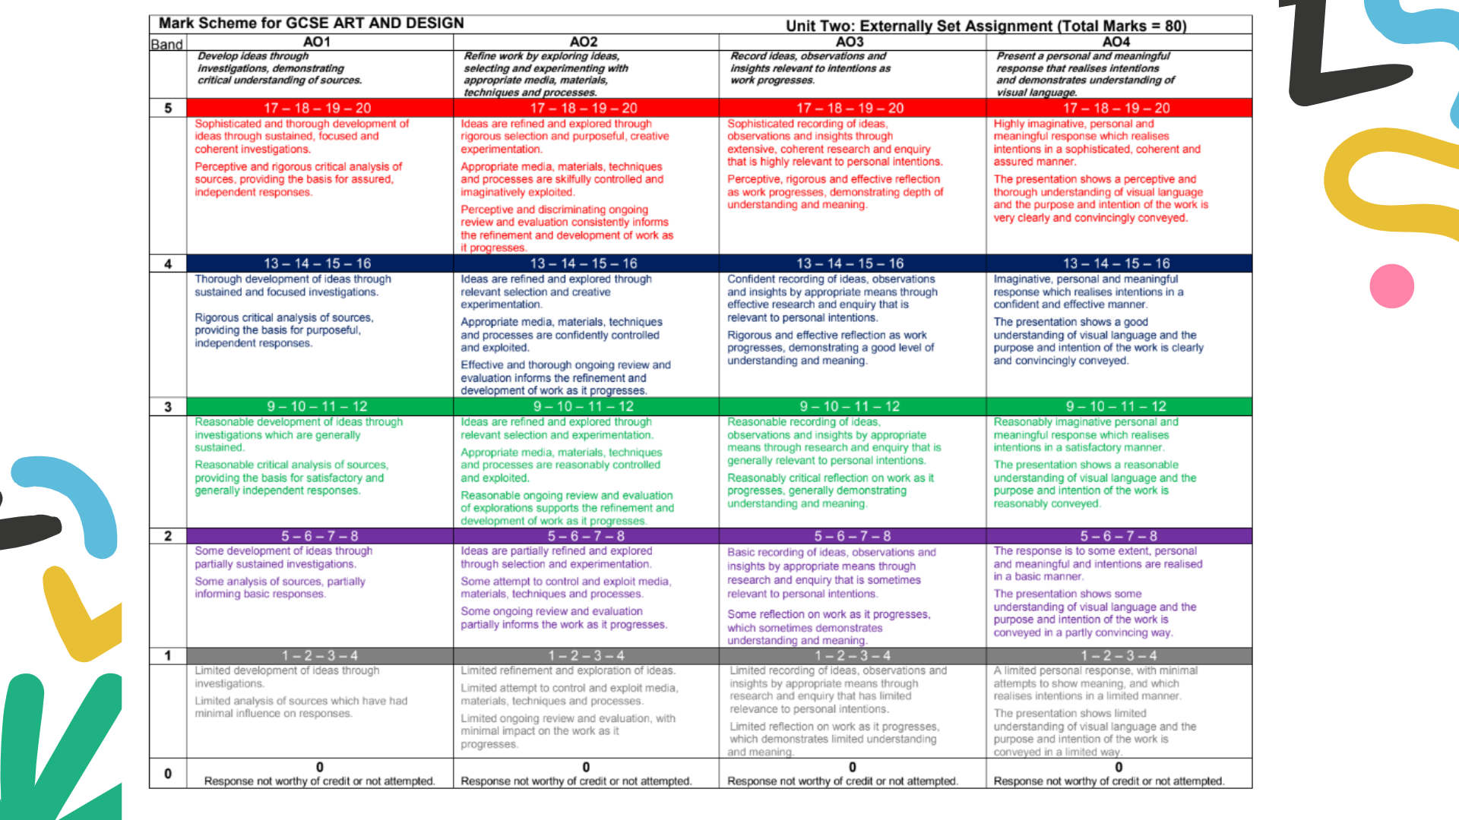
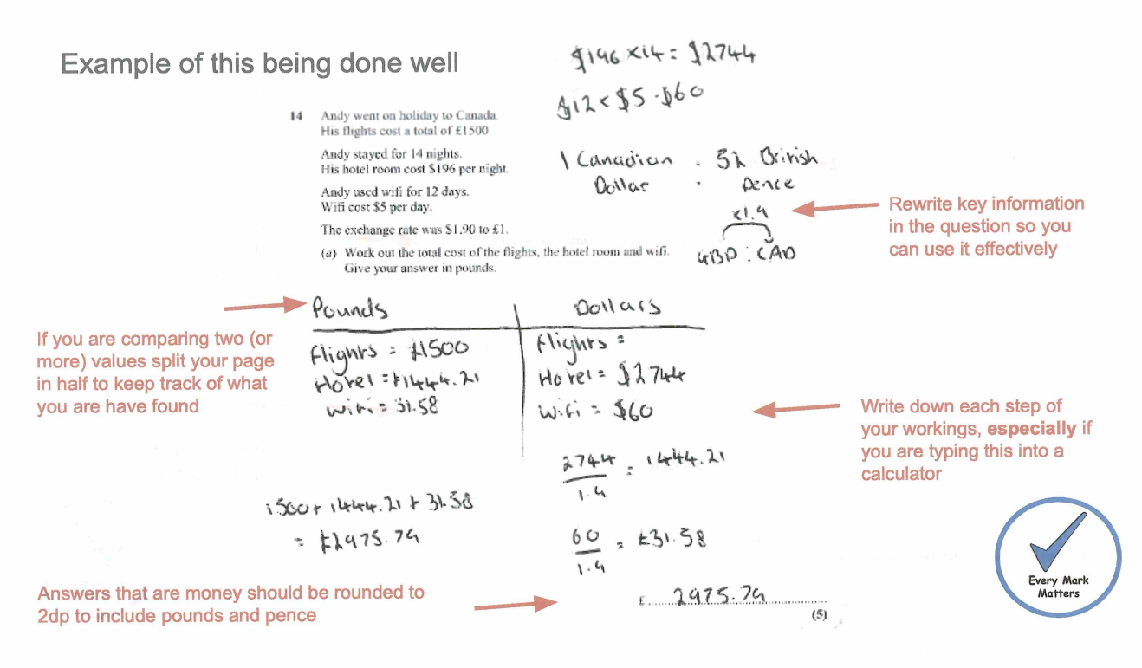
Exam Rubric
Description
Criteria
Levels
Standards
For example . . .

Slide 27
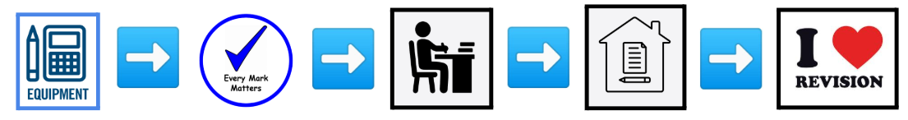
Exam Rubric
Ensure every GCSE student has an Exam Rubric for each subject - these are available either as a paper copy and on each subject’s Google Classroom and the Year 10 and 11 Exam Rubric Google Classroom.
Value and recognise the importance of this document in helping students to access every available mark in their exams - we know that Every Mark Matters.
Direct students to use and make reference to their Exam Rubric during lesson time - for example, practical use of knowledge organisers and using mark schemes for reference.
Direct students to use and make reference to their Exam Rubric when completing homework tasks - they contain a wealth of information that can help students to be more independent in each subject.
Direct students to use and make reference to their Exam Rubric when completing revision - they contain lots of information that can help students to complete, for example, the Fab Four Revision Strategies.
To get the most out of Exam Rubric, at Millthorpe we:

Slide 28




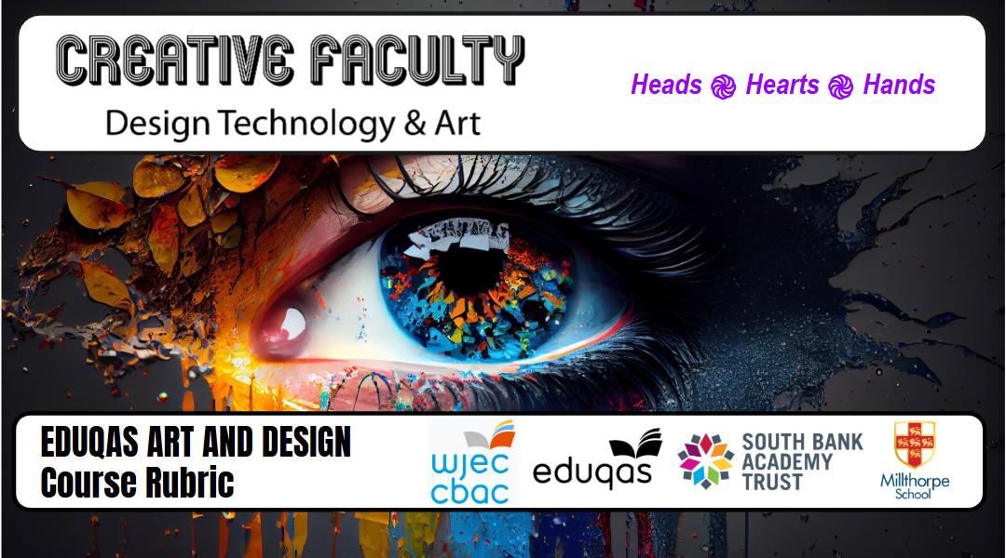
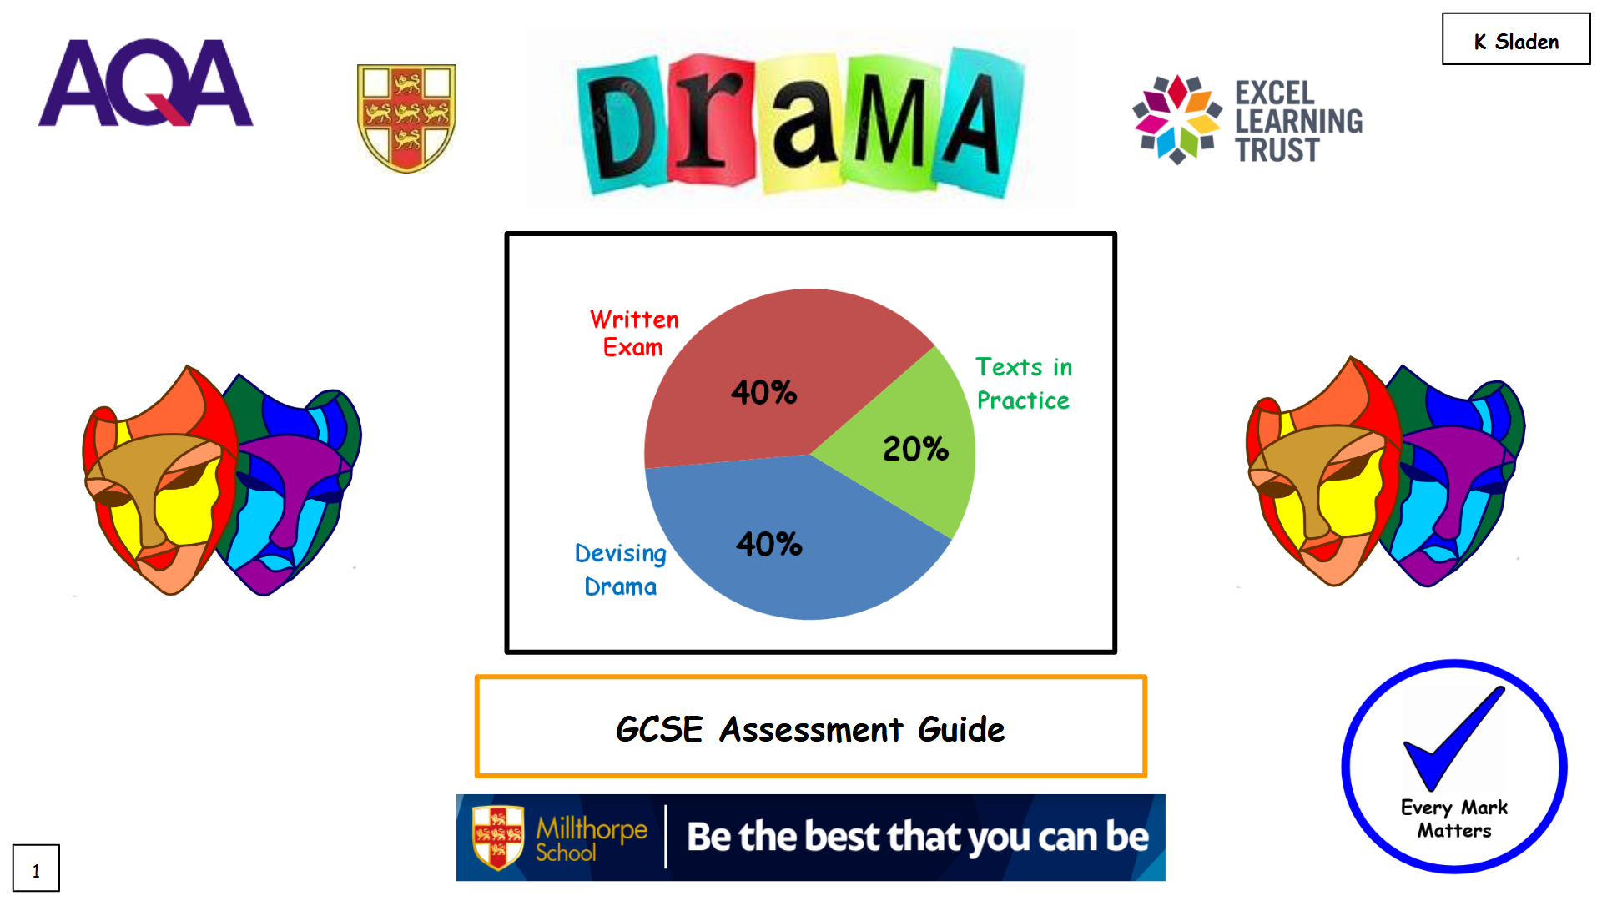
What is the difference between a Revision Guide and an Exam Rubric?
Made for YOU by YOUR teachers
Made for ANYONE / EVERYONE

Slide 29

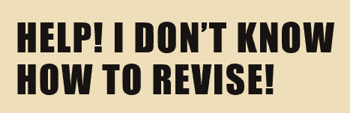
However, just having the Exam Rubric is not enough . . .

Slide 30

The word revision literally means to 'see again'. Revision helps you to remember the important facts, figures, topics and methods that you studied in the past so that you are able to recall these in the future, typically in an exam.
However, not all revision is good revision.
Passive revision, such as re-reading notes, highlighting/underlining text or copying out notes involve you receiving information without meaningful engagement. While these methods may feel productive, research consistently shows they actually have limited results.

Slide 31

In contrast, active revision requires you to engage actively with your subject material which strengthens your memory pathways and triggers several cognitive processes that enhance learning, making information easier to recall during exams.
The effort required in active revision – known as “desirable difficulty” – improves long-term retention.
At Millthorpe, we know that students can best use our ‘Fab Four’ Revision Strategies alongside your Exam Rubrics in order to engage in effective active revision across all subject areas.

Slide 32




At Millthorpe, we recommend and guide students to use the following research proven revision strategies:
2. Mind Maps
1. Brain Dumps
3. Flash Cards
4. Self Quizzing

Slide 33
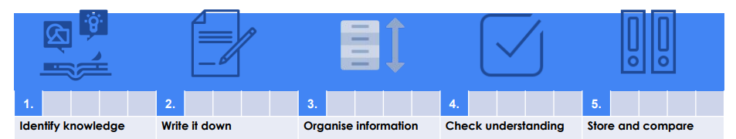

1. Brain Dumps
Give yourself a time limit - e.g. 10 minutes - write down everything you can remember about that topic.
Compare your brain dump to your Knowledge Organiser - correct misconceptions and add any information you missed in a different colour.
Use highlighters to look for links and categorise the words/ideas into groups.
Store your brain dump away in order to be able to revisit it later.
Decide which focussed area (unit/topic) you want to revise.
Available on our website under: Students - Revision Tips and Guidance

Slide 34
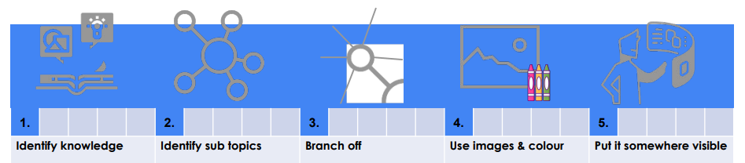
2. Mind Maps
Decide which focussed area (unit/topic) you want to revise - have your Knowledge Organisers in front of you.
Begin your mind map - place the main topic in the middle and identify subtopics that will branch off.
Branch off your subtopics with further detail - not too much writing, though - make it easy to recall and visualise.
Place your completed mind maps in places where you can see them frequently.
Use pictures and colour to help this process.
Available on our website under: Students - Revision Tips and Guidance

Slide 35
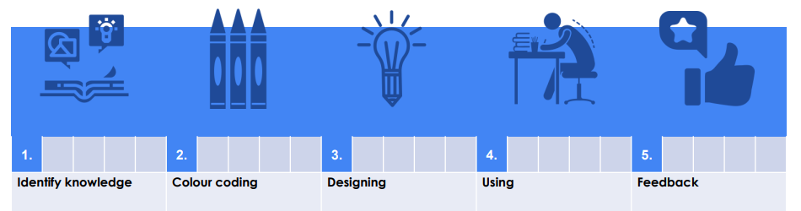
3. Flash Cards
Write one clear question per flashcard - these should be questions that require short, specific knowledge-based answers.
Look at the question and write your answer down then check, or say your answers out loud and check.
Review your performance and use the Leitner system to test your knowledge over time.
Decide which focussed area (unit/topic) you want to revise - have your Knowledge Organisers in front of you.
Use different coloured flash cards for different topics to help with organisation.
Available on our website under: Students - Revision Tips and Guidance

Slide 36
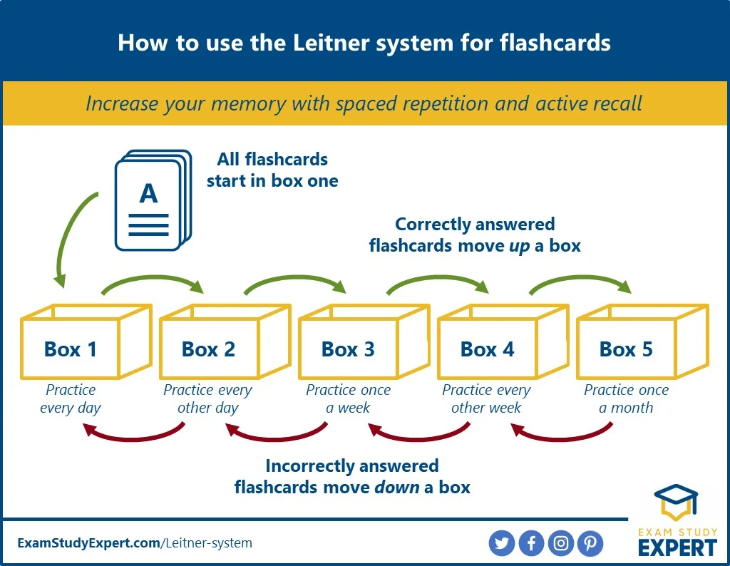
3. Flash Cards
Use Flashcards to Close the Gaps in your Knowledge:
Begin with all of your flashcards in one pile - as you test yourself, those that you are secure with can be stored away to revisit progressively less regularly, those that you are not confident with keep ‘active’ to revisit more regularly until this knowledge becomes secure.
Write one clear question per flashcard - these should be questions that require short, specific knowledge-based answers.
Look at the question and write your answer down then check, or say your answers out loud and check.
Review your performance and use the Leitner system to test your knowledge over time.
Decide which focussed area (unit/topic) you want to revise - have your Knowledge Organisers in front of you.
Use different coloured flash cards for different topics to help with organisation.
Available on our website under: Students - Revision Tips and Guidance

Slide 37
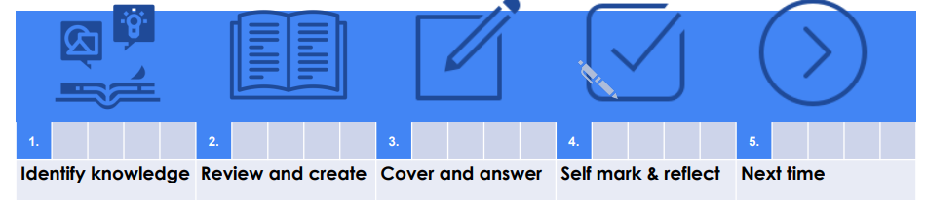
4. Self Quizzing
Spend 5-10 minutes reviewing knowledge using a Knowledge Organiser. Create 10 questions on the topic.
Cover up your Knowledge Organiser and answer the questions from memory.
Using your Knowledge Organiser self-mark your answers in green pen.
Revisit the areas where there were gaps in knowledge and include these same questions next time.
Decide which focussed area (unit/topic) you want to revise.
Available on our website under: Students - Revision Tips and Guidance

Slide 38

1. Brain Dumps
2. Mind Maps
3. Flash Cards
4. Self Quizzing
REMEMBER: A desirable difficulty is a learning task that is not particularly easy and requires a desirable amount of effort to complete or solve. This effort improves long-term memory and performance - perfect for exam success!

Slide 39
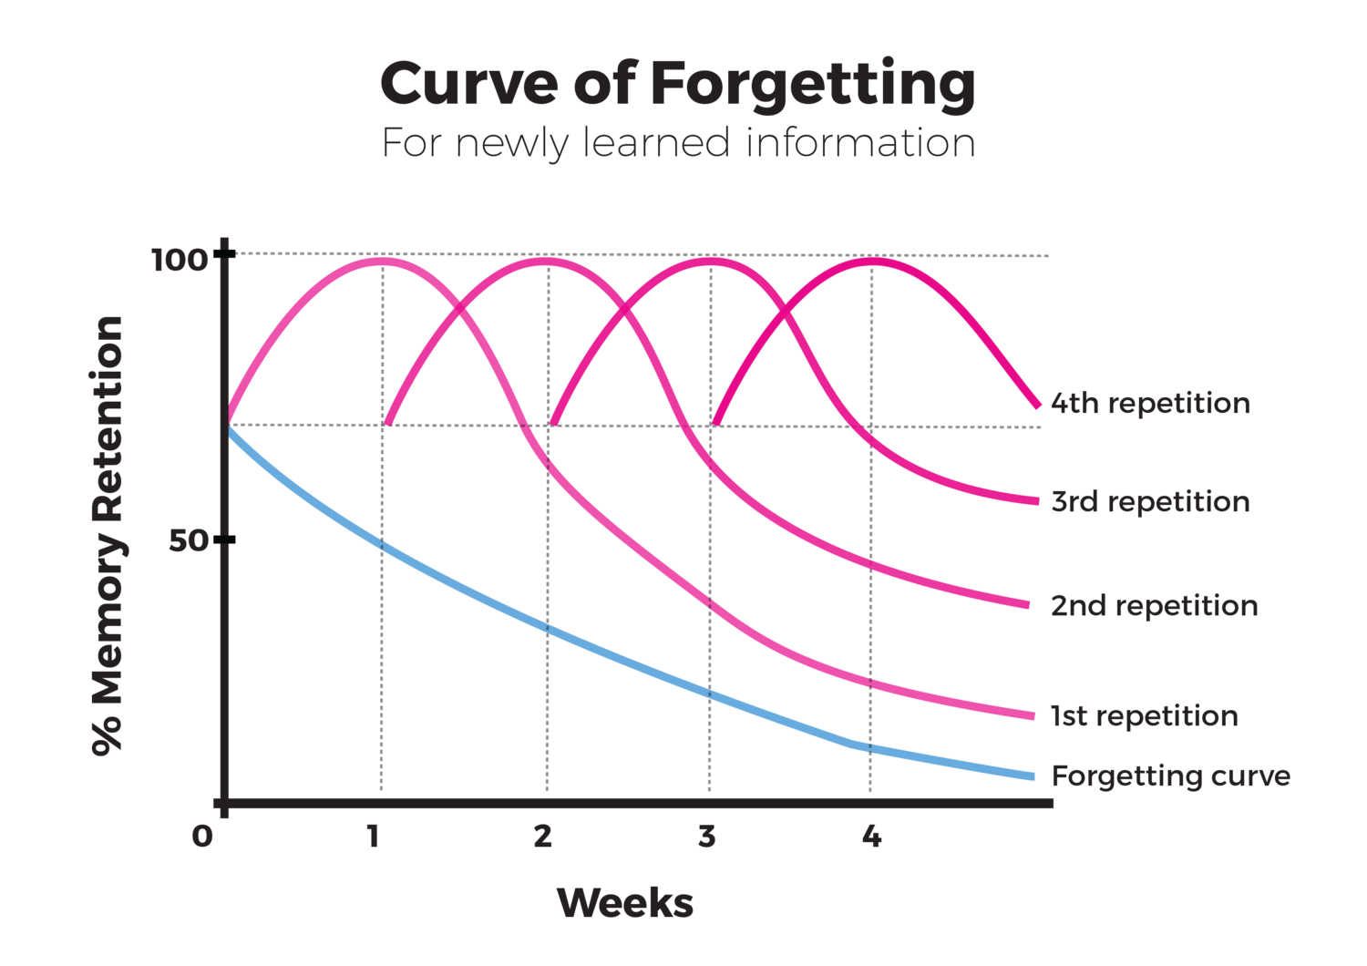

Ultimately, repetition over time is how you create long term memory.
Regularly experiencing that desirable difficulty - a little and often - is the key to success.

Slide 40
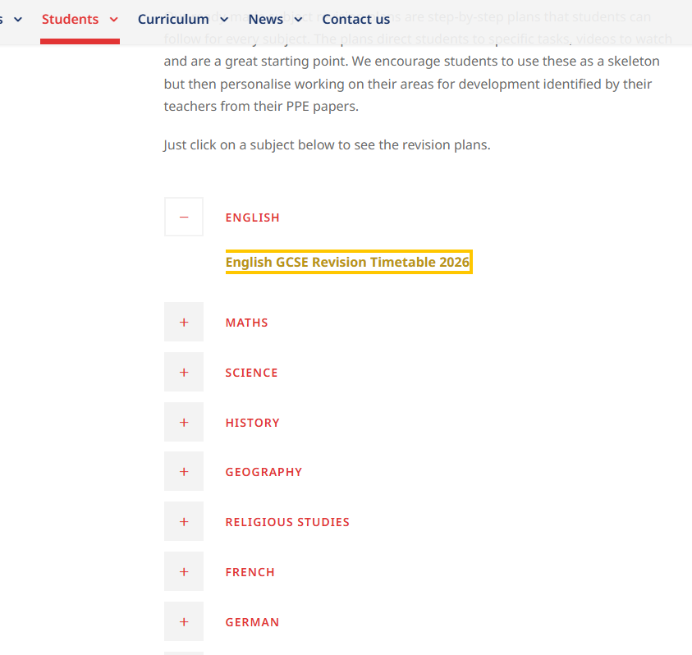
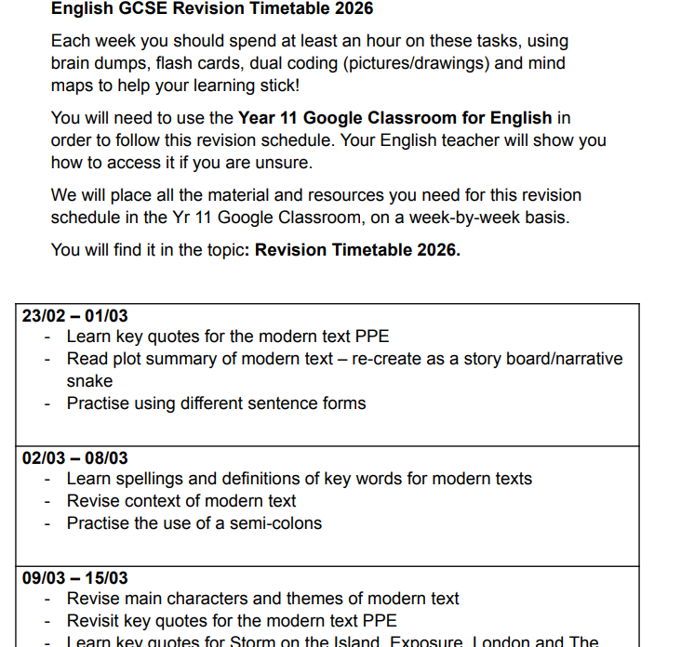
Subject Specific Revision Plans- Ready made revision
All accessible via Google classroom:

Slide 41
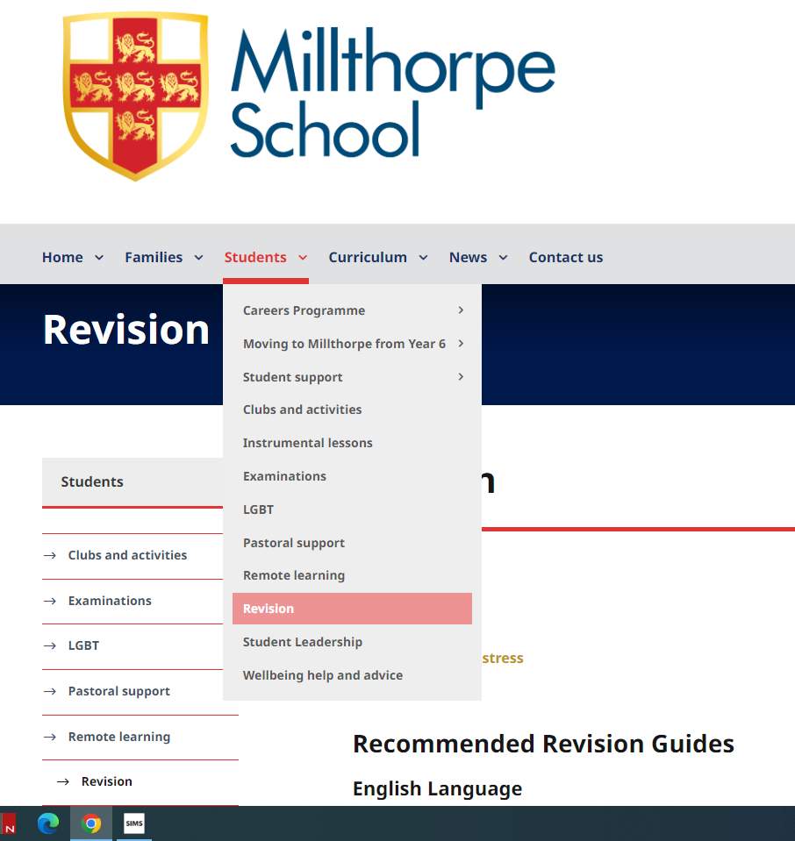
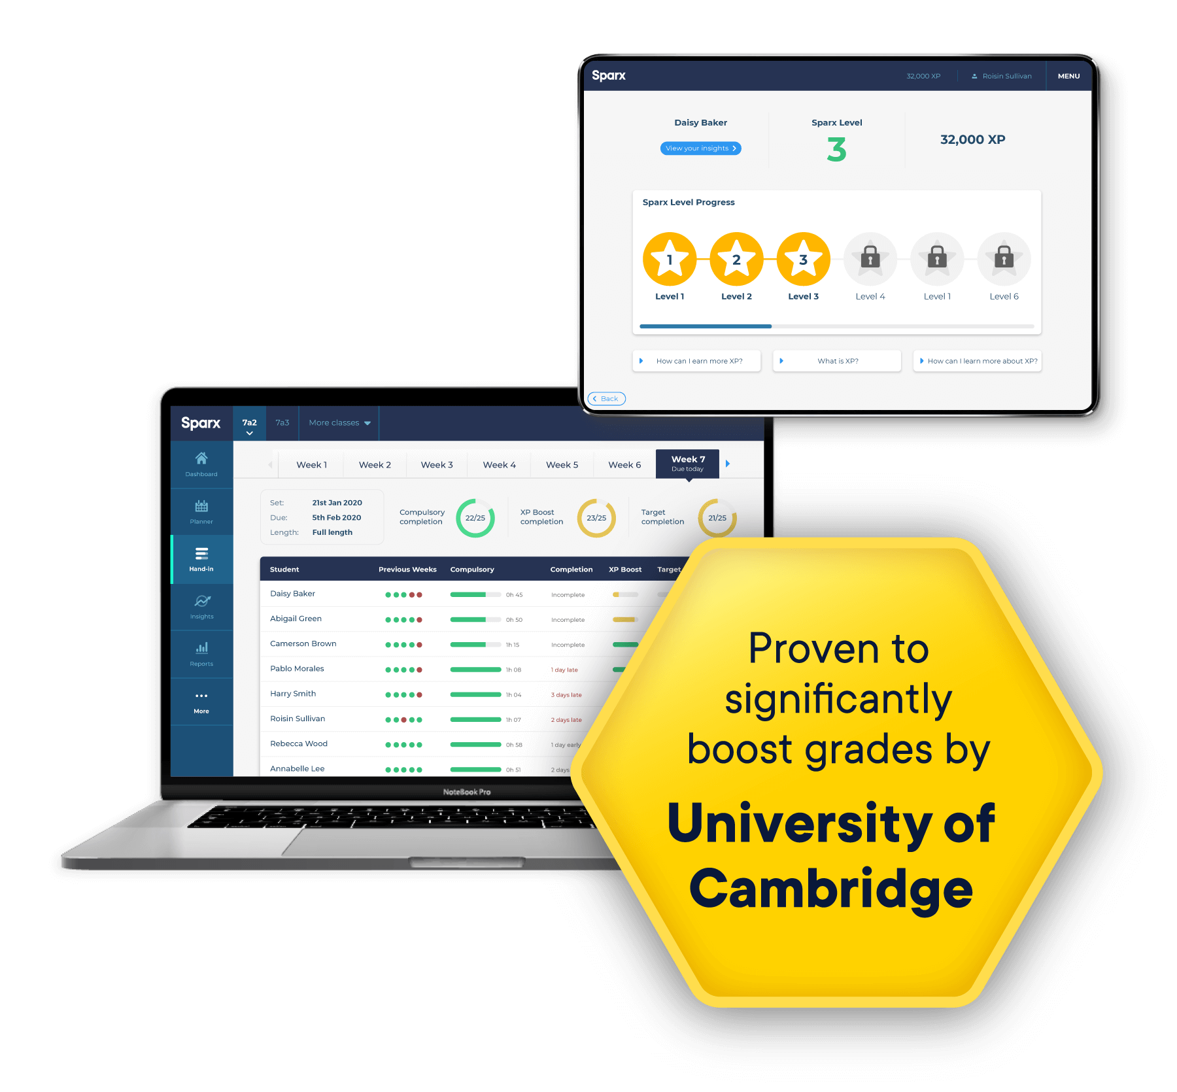

Other Sources of Revision:
SPARX
SENECA
Rubric Guides and Knowledge Organisers
Revision Guides
Podcasts
Youtube

Slide 42


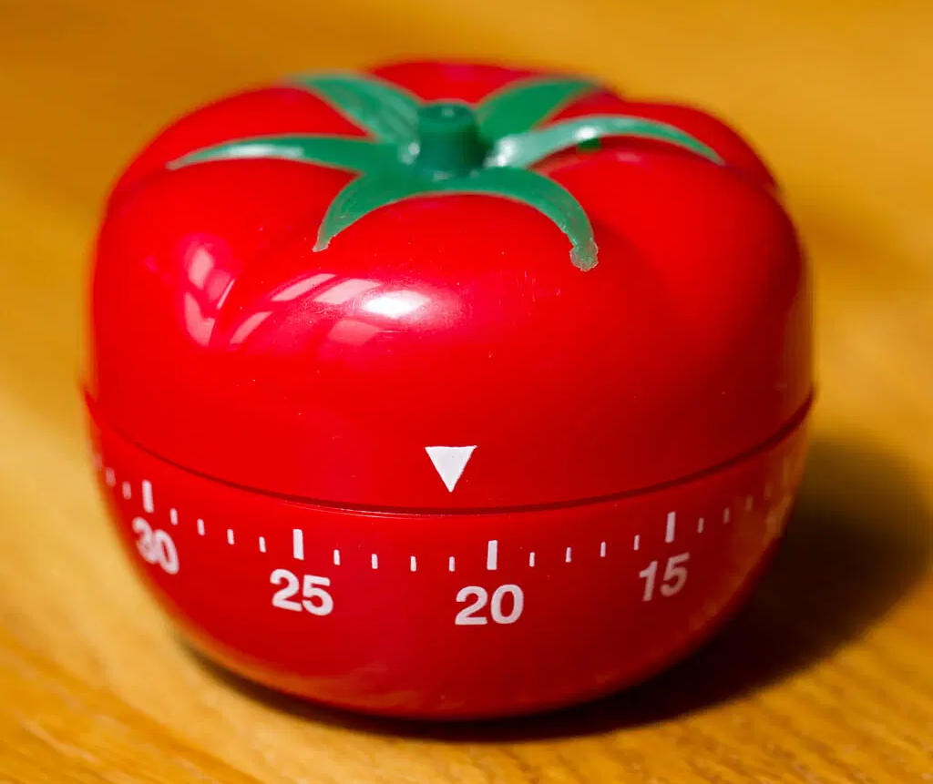
Be regular
Be consistent
Be specific
Be focused…avoid distractions
Be comfortable
Use the Fab Four Revision Strategies - experience that desirable difficulty!
Pomodoro - short work periods with breaks and rewards.

Slide 43
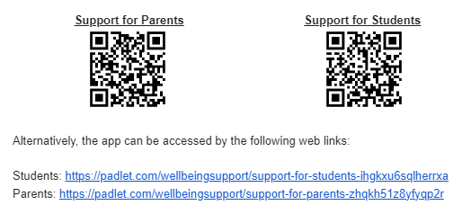
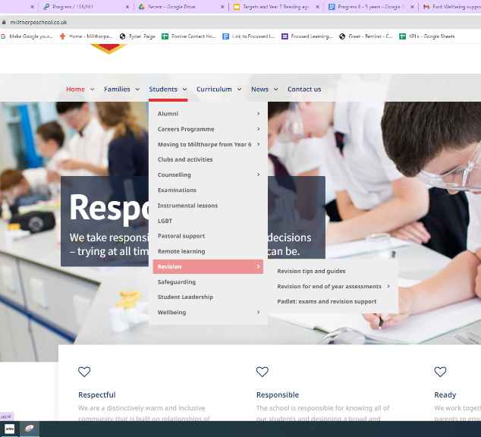
How can you support your child and their wellbeing?

Slide 44
This evening we also have:
Back of the hall
Revision and Rubric Guides
SLT members
Information Booklets
B5
York College
Joseph Rowntree
Fulford School
B4
Progress Leader
SEND team
SLT members

